Slide 1

Software QUALITY ENGINERING
SQA Process Implementation Activities

Slide 2
Agenda
I. Introduction
Define SQA (Software Quality Assurance)
Importance of SQA process implementation
Brief overview of SQA process implementation activities
II. SQA Process Implementation Activities
Planning
Requirements Review
Design Review
Code Review
Testing
Documentation
III. Conclusion

Slide 3
Importance of SQA process implementation
The importance of SQA process implementation lies in the fact that software is an essential component of many products and services. Software defects can lead to financial losses, reduced productivity, and damage to reputation. Therefore, it is crucial to implement SQA processes to ensure that software products are reliable, efficient, and meet user requirements.

Slide 4
Importance of SQA process implementation
The SQA process involves a set of activities that ensure that the software being developed meets the desired quality standards and is free of defects. Here are some reasons why implementing the SQA process is essential:
Improved software quality: Implementing the SQA process helps to ensure that the software is developed to meet the required quality standards. By detecting and fixing defects early in the development cycle, the overall quality of the software is improved, and the likelihood of delivering a high-quality product is increased.
Reduced cost: Detecting and fixing defects early in the development cycle is less expensive than fixing them after the software has been released. By implementing the SQA process, the cost of fixing defects is significantly reduced, and the overall cost of developing software is lowered.
Better risk management: The SQA process helps to identify potential risks early in the development cycle. By identifying these risks early, they can be managed effectively, reducing the impact they may have on the project's success.
Increased customer satisfaction: Developing high-quality software that meets customer requirements is essential to ensuring customer satisfaction. By implementing the SQA process, software development companies can ensure that the software meets customer requirements and is delivered on time.
Compliance with regulations: Many industries have regulations and standards that must be met when developing software. The SQA process helps to ensure that the software meets these standards, ensuring compliance and reducing the risk of legal action.

Slide 5
A brief overview of SQA process implementation activities includes
Planning: In this phase, SQA objectives and scope are defined, and a plan for SQA activities is developed. This includes identifying resources and defining roles and responsibilities for the SQA team.
Requirements Review: This phase involves reviewing and verifying software requirements to ensure they are complete, correct, and testable. Any inconsistencies or ambiguities in requirements are identified and addressed.
Design Review: In this phase, software design documents are reviewed and verified to ensure they meet the requirements. Any potential design flaws or weaknesses are identified and addressed.
Code Review: The purpose of this phase is to review and verify the software code. The code is checked to ensure that it meets the design and requirements. Any coding errors or vulnerabilities are identified and addressed.

Slide 6
A brief overview of SQA process implementation activities includes
Testing: This phase involves conducting various types of testing, such as unit, integration, system, and acceptance testing. The software is tested to ensure that it meets the requirements and design, and any defects or issues found during testing are identified and addressed.
Documentation: In this phase, documentation is created and maintained, such as test plans, test cases, and test scripts. The documentation is checked to ensure that it is accurate and up-to-date.
By implementing these SQA process activities, software products can be developed and released with high quality and minimal defects, leading to improved customer satisfaction and success in the market.

Slide 7

Planning

Slide 8
Planning
Planning is the first and most important phase of SQA process implementation. In this phase, SQA objectives and scope are defined, and a plan for SQA activities is developed. Identifying resources and defining roles and responsibilities are also part of this phase
Defining SQA Objectives and Scope
Developing a Plan for SQA Activities
Identifying Resources and Defining Roles and Responsibilities

Slide 9

Defining SQA Objectives and Scope

Slide 10
Defining SQA Objectives and Scope
The first step in planning is to define the objectives of the SQA process. This includes understanding the quality requirements of the software product or service, the user's needs, and the company's goals. Once the objectives are defined, the scope of the SQA process can be established. The scope includes the software product's functional and non-functional requirements, testing needs, and the resources required for SQA activities.

Slide 11
Defining SQA Objectives and Scope
In this stage, the SQA team will identify the objectives and scope of the SQA activities. The objective of the SQA team is to ensure that the software development project meets the quality standards and the requirements of the stakeholders. The scope of the SQA activities includes identifying, analyzing, and mitigating potential risks associated with the software development project.
For example, let's consider a software development project for a new mobile banking application. The SQA objectives would be to ensure that the application is secure, reliable, and user-friendly. The scope of the SQA activities would include identifying potential security vulnerabilities, analyzing the application's performance, and ensuring that the application meets the requirements of the stakeholders.

Slide 12
Developing a Plan for SQA Activities
Once the SQA objectives and scope are defined, a plan for SQA activities is developed. This plan outlines the activities, tasks, and timelines for each phase of the SQA process. The plan also includes details on the resources needed, such as personnel, hardware, and software tools.

Slide 13
Developing a Plan for SQA Activities
In this stage, the SQA team will develop a plan for the SQA activities. This plan should include a detailed description of the activities that will be performed, the resources required to complete these activities, and the timeline for completion.
Continuing with our example of a mobile banking application, the SQA plan would include activities such as reviewing the software requirements and design documents, conducting various types of testing (such as unit, integration, and system testing), and creating and maintaining documentation. The plan would also include the resources required to complete these activities, such as SQA team members, testing tools, and software development environments. The timeline for completion of each activity should be included in the plan as well.

Slide 14
Identifying Resources and Defining Roles and Responsibilities
In the planning phase, resources required for SQA activities are identified, and roles and responsibilities are defined for each team member. This includes identifying the personnel who will be involved in SQA activities, such as SQA engineers, testers, and project managers. The roles and responsibilities of each team member are defined to ensure that everyone understands their role in the SQA process.

Slide 15
Identifying Resources and Defining Roles and Responsibilities
In this stage, the SQA team will identify the resources required to complete the SQA activities and define the roles and responsibilities of each team member.
For example, in our mobile banking application project, the SQA team would need resources such as testing tools, software development environments, and testing environments. The SQA team members' roles and responsibilities would include reviewing software requirements and design documents, conducting various types of testing, creating and maintaining documentation, and reporting defects and issues to the development team. The SQA team leader would be responsible for coordinating the SQA activities and ensuring that the team members are completing their tasks as per the plan.

Slide 16
Conclusion OF Planning phase
By completing the planning phase, the SQA team can establish clear objectives, scope, and plan for SQA activities. This ensures that everyone is aligned and aware of their roles and responsibilities, which can lead to a more effective and efficient SQA process.

Slide 17
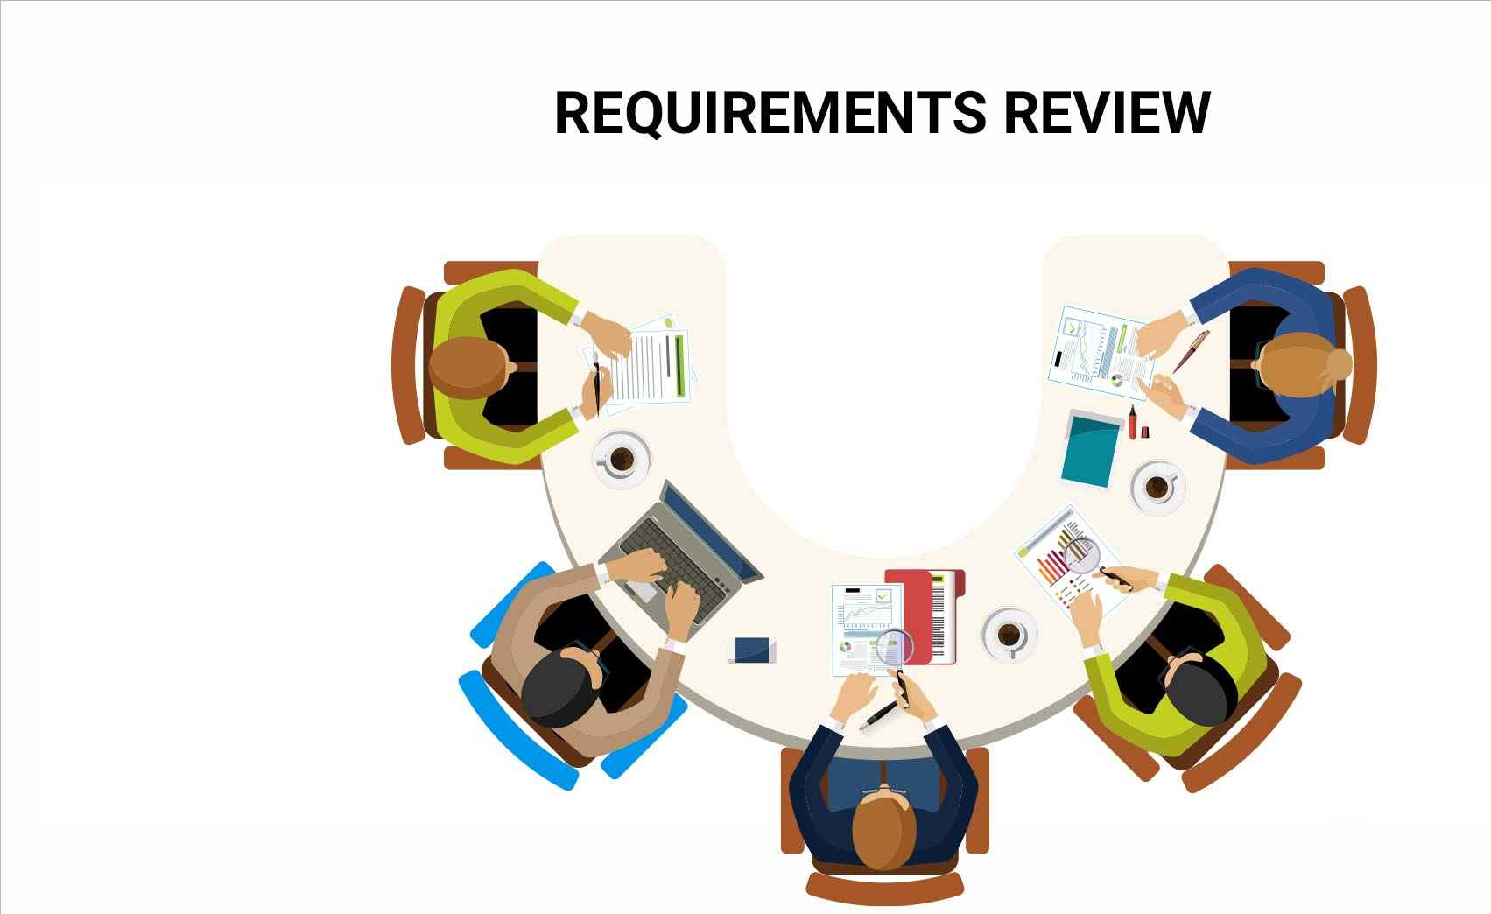
Requirements Review

Slide 18
Requirements Review
Requirements Review is the second phase of SQA process implementation. In this phase, software requirements are reviewed and verified to ensure that they are complete, correct, and testable. The following are the key activities that are part of the requirements review phase:
Reviewing and Verifying Software Requirements
Ensuring Requirements are Testable and Traceable
Identifying and Addressing Any Inconsistencies or Ambiguities in Requirements

Slide 19
Reviewing and Verifying Software Requirements
The first step in the requirements review phase is to review and verify the software requirements. This involves analyzing the requirements to ensure that they are complete and accurate. The requirements should also be verified to ensure that they meet the user's needs and expectations.

Slide 20
Reviewing and Verifying Software Requirements
This involves reviewing and analyzing the software requirements to ensure that they are complete, accurate, and meet the needs of the end-users. The SQA team will review the requirements document and verify that all the required features and functionalities are included. They will also check if the requirements are clearly defined, concise, and free of any ambiguity.
For example, suppose a company is developing a new payroll system. During the requirements review stage, the SQA team will review the requirements document to ensure that all the required features, such as employee information management, time tracking, and tax calculations, are included. They will also verify that the requirements are clear and unambiguous, for instance, by ensuring that the definition of employee status (e.g., full-time, part-time, or contract) is clearly stated and consistently used throughout the requirements document.

Slide 21
Ensuring Requirements are Testable and Traceable
The second step is to ensure that the requirements are testable and traceable. Testable requirements are those that can be validated through testing. Traceable requirements are those that can be traced throughout the software development life cycle, from requirements to design, development, testing, and deployment. Traceability ensures that the software meets the requirements and objectives.

Slide 22
Ensuring Requirements are Testable and Traceable
This involves ensuring that the requirements are written in such a way that they can be tested and that the test results can be traced back to the specific requirement. The SQA team will review the requirements document to ensure that each requirement is testable, and that there is a clear and traceable link between the requirement and the corresponding test case.
For example, suppose the requirement for employee information management in the payroll system specifies that the system must allow employees to update their personal information (e.g., address, contact details) at any time. In this case, the SQA team will ensure that there is a test case that verifies the functionality of the employee information management feature and that the test results can be traced back to this requirement.

Slide 23
Identifying and Addressing Any Inconsistencies or Ambiguities in Requirements
During the requirements review, any inconsistencies or ambiguities in the requirements are identified and addressed. Inconsistencies occur when two or more requirements contradict each other, or when a requirement conflicts with the user's needs. Ambiguities occur when a requirement is unclear or can be interpreted in multiple ways. Identifying and addressing these issues ensures that the software development team understands the requirements and can develop software that meets the user's needs.

Slide 24
Identifying and Addressing Any Inconsistencies or Ambiguities in Requirements
This involves identifying any inconsistencies, conflicts, or ambiguities in the requirements and addressing them before the development process begins. The SQA team will review the requirements document and look for any conflicts or inconsistencies between requirements, such as two requirements that specify different data formats for the same input field. They will also identify any ambiguous or unclear requirements and work with the business analyst to clarify and rephrase them.
For example, suppose the payroll system requirements document includes a requirement that states "the system should be user-friendly." This requirement is ambiguous and open to interpretation, making it difficult to test or verify. In this case, the SQA team will work with the business analyst to clarify this requirement, for instance, by defining specific usability criteria (e.g., clear and intuitive user interface, easy-to-follow instructions) that can be objectively tested and verified.

Slide 25
Conclusion OF Requirements Review PHASE
By completing the requirements review phase, the SQA team can ensure that the software requirements are complete, accurate, and testable. This ensures that the software development team has a clear understanding of the requirements and can develop software that meets the user's needs. Additionally, the traceability of requirements ensures that the software can be tested and validated throughout the software development life cycle.

Slide 26

Design Review

Slide 27
Design Review
Design Review is the third phase of SQA process implementation. In this phase, software design documents are reviewed and verified to ensure that they meet the software requirements. The following are the key activities that are part of the design review phase:
Reviewing and Verifying Software Design Documents
Ensuring Design Meets Requirements
Identifying and Addressing Any Potential Design Flaws or Weaknesses

Slide 28
Reviewing and Verifying Software Design Documents
The first step in the design review phase is to review and verify the software design documents. The design documents should be analyzed to ensure that they meet the software requirements and that they provide a clear and comprehensive design for the software system.
This involves conducting a thorough review of the design documents to ensure that they are complete, accurate, and consistent with the project requirements. The review process should involve all relevant stakeholders, including the software designers, software architects, and project managers. Reviewing the design documents can help identify any errors or omissions in the design before coding begins, saving time and effort later in the project.

Slide 29
Ensuring Design Meets Requirements
The first step in the design review phase is to review and verify the software design documents. The design documents should be analyzed to ensure that they meet the software requirements and that they provide a clear and comprehensive design for the software system.
The design should accurately reflect the software requirements and should meet the intended purpose of the software. The design should also be scalable and maintainable to accommodate future changes or upgrades. A design review helps to identify any discrepancies between the requirements and design and ensures that the design meets the project's goals and objectives.

Slide 30
Example
For example, suppose a software development project requires the creation of an e-commerce website with a shopping cart feature. The design review would ensure that the design of the website and shopping cart feature are aligned with the project requirements and functional specifications. The design would also be evaluated for scalability and maintainability, ensuring that the software can handle future changes or upgrades.

Slide 31
Identifying and Addressing any Potential Design Flaws or Weaknesses
During the design review, any potential design flaws or weaknesses are identified and addressed. This includes reviewing the design for any security vulnerabilities, performance issues, or other potential problems. Design flaws or weaknesses can be addressed through design changes or by implementing additional measures to mitigate the risks.
A design review can help identify potential design flaws or weaknesses that could lead to issues in the future. These could include security vulnerabilities, performance bottlenecks, or design elements that are difficult to implement. Identifying and addressing these issues early in the development process can help reduce project risks and improve software quality.
For example, during the design review of a healthcare management system, a potential design flaw is identified in the data encryption process, which could result in sensitive patient data being exposed. The flaw is addressed by redesigning the encryption process, ensuring that sensitive data is fully protected.

Slide 32
Conclusion OF Design Review phase
By completing the design review phase, the SQA team can ensure that the software design meets the requirements and that there are no potential design flaws or weaknesses. This ensures that the software development team has a clear understanding of the design and can develop software that meets the user's needs. Additionally, identifying and addressing potential design flaws or weaknesses can help reduce the risk of problems or issues later in the software development life cycle.

Slide 33
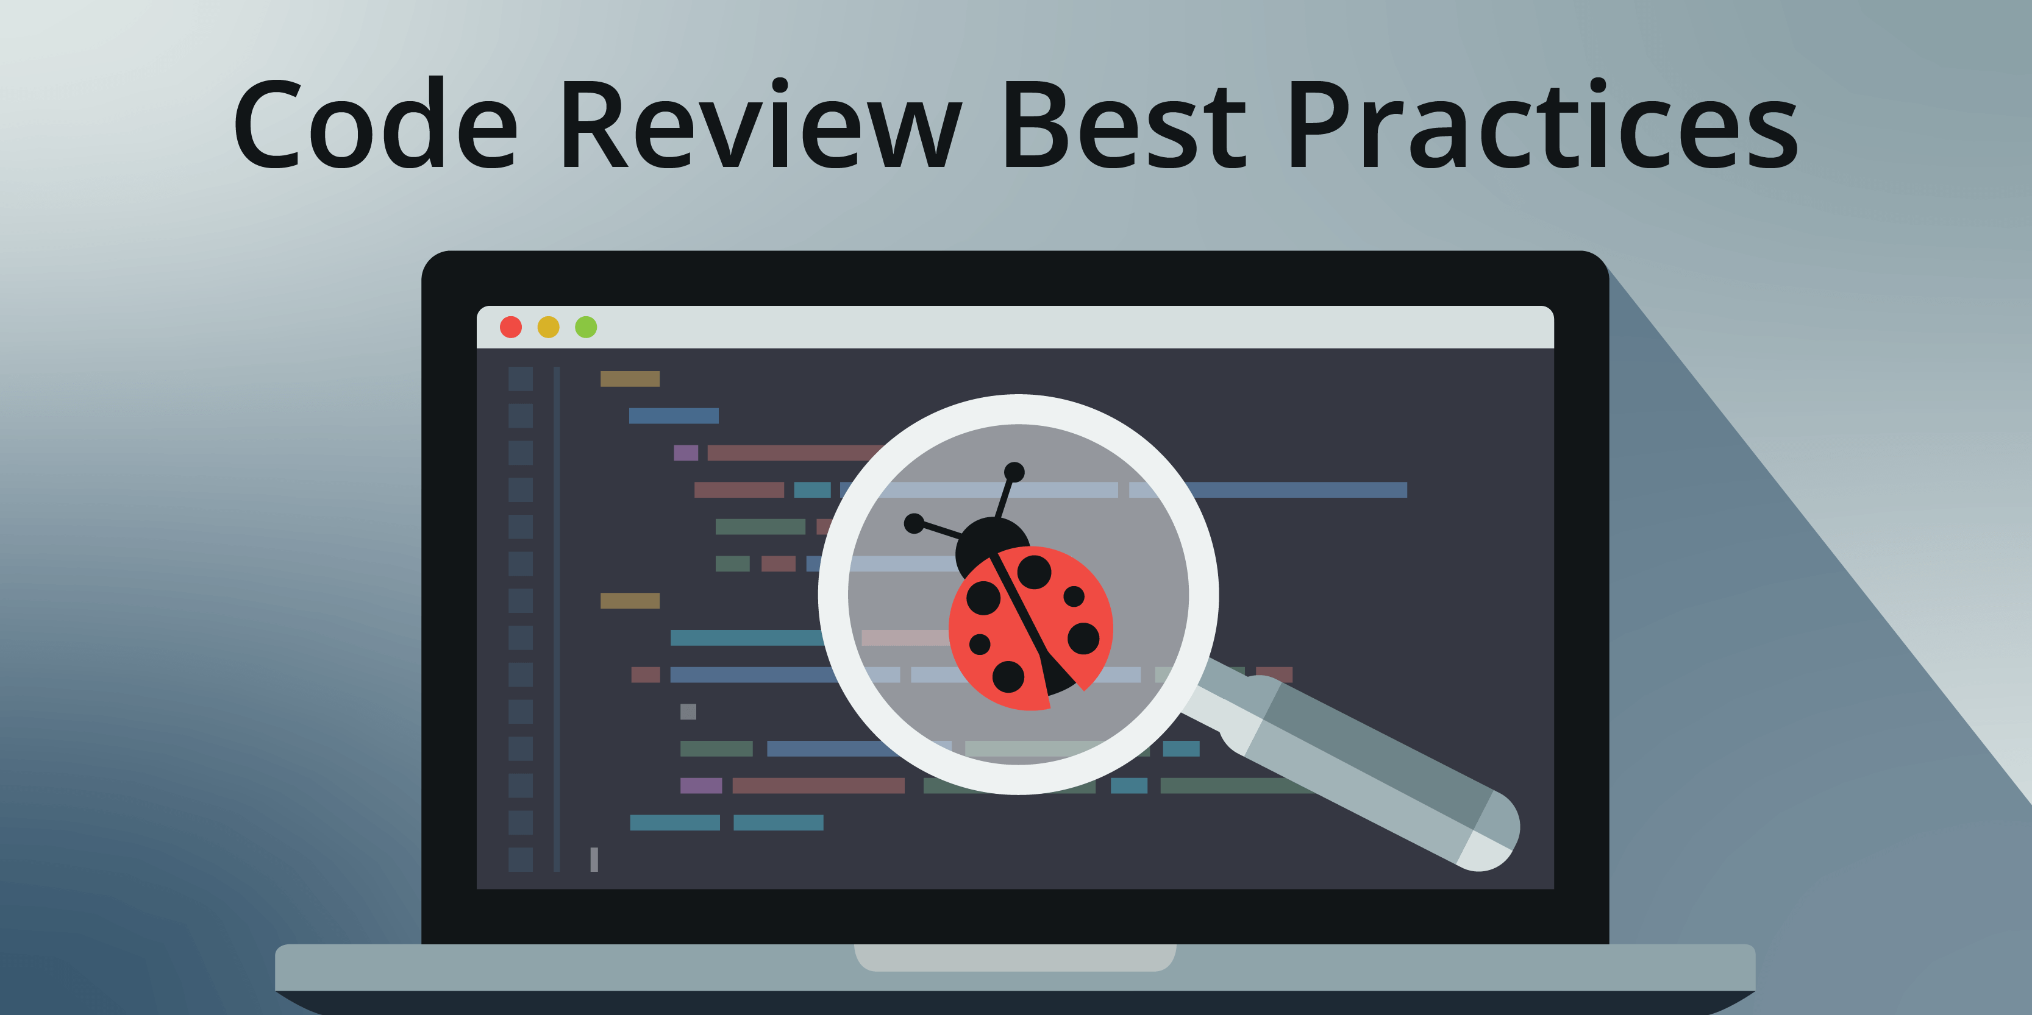
Code Review

Slide 34
Code Review
Code Review is the fourth phase of SQA process implementation. In this phase, software code is reviewed and verified to ensure that it meets the design and requirements, and that there are no coding errors or vulnerabilities. The following are the key activities that are part of the code review phase:
Reviewing and Verifying Software Code
Ensuring Code Meets Design and Requirements
Identifying and Addressing any Coding Errors or Vulnerabilities

Slide 35
Reviewing and Verifying Software Code
The first step in the code review phase is to review and verify the software code. This involves analyzing the code to ensure that it meets the design and requirements, and that it is consistent with the software design documents. The code should also be verified to ensure that it is complete, accurate, and testable.
Example: Let's say that the software requirement is to create an e-commerce website that allows users to purchase products online. During the code review, the SQA team would verify that the code includes all the necessary features, such as a shopping cart, payment processing, and user authentication.

Slide 36
Ensuring Code Meets Design and Requirements
The second step is to ensure that the code meets the design and requirements. The code should be reviewed to ensure that it meets the user's needs and expectations. This includes ensuring that the code is scalable, maintainable, and can be easily modified in the future.
Example: In the e-commerce website example, the SQA team would review the code to ensure that it meets the design requirements, such as using a secure payment processing system and allowing users to view their purchase history.

Slide 37
Identifying and Addressing any Coding Errors or Vulnerabilities
During the code review, any coding errors or vulnerabilities are identified and addressed. This includes reviewing the code for any security vulnerabilities, performance issues, or other potential problems. Coding errors or vulnerabilities can be addressed through code changes or by implementing additional measures to mitigate the risks.
Example: In the e-commerce website example, the SQA team would review the code to ensure that it is secure and that there are no vulnerabilities that could be exploited by attackers. They might look for common coding errors, such as SQL injection vulnerabilities, and ensure that the code includes appropriate input validation and sanitization measures.

Slide 38
Conclusion OF CODE REVIEW phase
By completing the code review phase, the SQA team can ensure that the software code meets the design and requirements, and that there are no coding errors or vulnerabilities. This ensures that the software development team has a clear understanding of the code and can develop software that meets the user's needs. Additionally, identifying and addressing coding errors or vulnerabilities can help reduce the risk of problems or issues later in the software development life cycle.

Slide 39

TESTING

Slide 40
TESTING
Testing is the fifth and final phase of the SQA process implementation. In this phase, various types of testing are conducted to verify that the software meets the requirements and design, and to identify and address any defects or issues found during testing. The following are the key activities that are part of the testing phase:
Conducting Various Types of Testing
Verifying Software Meets Requirements and Design
Identifying and Addressing any Defects or Issues Found During Testing

Slide 41
Conducting Various Types of Testing
Different types of testing are conducted during the testing phase to verify that the software functions correctly and meets the requirements and design. These types of testing include unit testing, integration testing, system testing, and acceptance testing. Unit testing involves testing individual components or modules of the software, while integration testing verifies that the modules work together as expected. System testing tests the entire system, while acceptance testing involves testing the software in a real-world scenario.
Example: Let's say that the software requirement is to create a mobile banking application. During the testing phase, unit testing would be conducted to verify the functionality of individual components, such as the login feature. Integration testing would ensure that the login feature works together with other features, such as account balances. System testing would test the entire application, and acceptance testing would ensure that the application meets the user's needs and expectations.

Slide 42
Verifying Software Meets Requirements and Design
The second step is to verify that the software meets the requirements and design. This involves ensuring that the software functions as expected and that it meets the user's needs and expectations. Verification of the software can be done through manual testing or automated testing.
Example: In the mobile banking application example, verification would involve ensuring that the login feature functions correctly and securely, that the account balances are accurate, and that the user interface is user-friendly and easy to navigate.

Slide 43
Identifying and Addressing any Defects or Issues Found During Testing
During testing, any defects or issues found are identified and addressed. This involves documenting the defects or issues and prioritizing them based on their severity. The development team can then address the defects or issues by making changes to the software code or by implementing additional measures to mitigate the risks.
Example: In the mobile banking application example, a defect might be found in the login feature that allows unauthorized access to user accounts. The SQA team would document this defect and prioritize it based on its severity. The development team would then address the defect by making changes to the code to ensure that the login feature is secure.

Slide 44
Conclusion OF TESTING PHASE
By completing the testing phase, the SQA team can ensure that the software functions correctly and meets the requirements and design. Identifying and addressing defects or issues found during testing can help reduce the risk of problems or issues later in the software development life cycle, ensuring that the software is of high quality and meets the user's needs and expectations.

Slide 45

Documentation

Slide 46
Documentation
Documentation is an essential part of the SQA process implementation. In this phase, various types of documentation are created and maintained to ensure that the software is thoroughly tested, and the documentation accurately reflects the testing that has been conducted. The following are the key activities that are part of the documentation phase:
Creating and Maintaining Documentation
Ensuring Documentation is Accurate and Up-to-Date
Identifying and Addressing any Documentation-Related Issues

Slide 47
Creating and Maintaining Documentation
The first step is to create and maintain documentation, including test plans, test cases, and test scripts. This documentation serves as a blueprint for testing and ensures that all aspects of the software are thoroughly tested. The documentation also provides a record of the testing that has been conducted, which can be useful for future reference.
Example: In the mobile banking application example, a test plan would be created that outlines the testing strategy for the application. This would include identifying the types of testing to be conducted, the testing environment, and the testing timeline. Test cases would then be created that outline the specific steps to be taken to test each aspect of the application, such as the login feature or the account balance display. Test scripts would also be created that automate the testing process to save time and increase efficiency.

Slide 48
Ensuring Documentation is Accurate and Up-to-Date
It's essential to ensure that the documentation accurately reflects the testing that has been conducted. This involves reviewing the documentation regularly to ensure that it is up-to-date and accurately reflects the current state of the software. Any changes or updates to the software should be reflected in the documentation.
Example: In the mobile banking application example, if a change is made to the login feature, the test plan, test cases, and test scripts would need to be updated to reflect the change. This ensures that the testing is conducted on the most up-to-date version of the software.

Slide 49
Identifying and Addressing any Documentation-Related Issues
During the documentation phase, any issues related to the documentation are identified and addressed. This includes identifying any inconsistencies or inaccuracies in the documentation and addressing them to ensure that the documentation is reliable.
Example: In the mobile banking application example, an issue might be identified where the test plan does not accurately reflect the testing that has been conducted. The SQA team would address this issue by updating the test plan to ensure that it accurately reflects the testing that has been conducted.

Slide 50
Conclusion OF Documentation PHASE
By completing the documentation phase, the SQA team can ensure that all aspects of the software are thoroughly tested, and the testing that has been conducted is accurately documented. This documentation can be useful for future reference, helping to ensure that the software remains of high quality and meets the user's needs and expectations.

Slide 51
Conclusion
In this lecture, we discussed the importance of implementing Software Quality Assurance (SQA) processes to ensure high-quality software and project success. We highlighted several key activities involved in SQA process implementation, including planning, requirements review, design review, code review, testing, and documentation. We provided detailed explanations and real-world examples for each of these activities. We concluded by emphasizing the importance of SQA process implementation and encouraging the audience to ask questions and engage in further discussion. Overall, SQA process implementation is crucial for ensuring that software meets requirements, is of high quality, and meets the needs of end-users.

Slide 52

END OF LECTURE
Any Questions !!!

